Slide 1
Week of December 16, 2013 & Long-Term Goals
Kyle Volle

Slide 2
A-matrix Metric
A is a lin. trans. from thrust space to torque space
Most generally, each vector space forms a parallelepiped
Determinant of A is the ratio of the volumes of these shapes
The determinant is a reasonable metric
An example of this transformation is shown on next 2 slides
As has been noted, yawing moment is limiting factor
This suggests other potential metrics

Slide 3
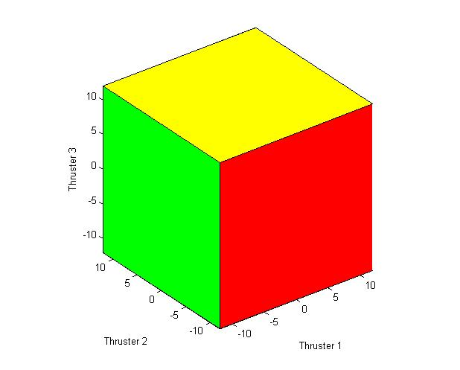
Thrust Space

Slide 4
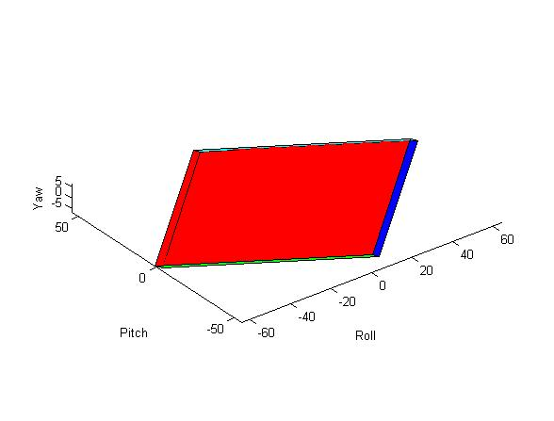
Torque Space

Slide 5
Comments
Note that the reachable yaw torques are an order of magnitude smaller than the others
Distance between faces most perpendicular to yaw axis is proportional to the norm of column 2.
These lead us to consider norm of column 2 and maximum yaw torque as other metrics

Slide 6
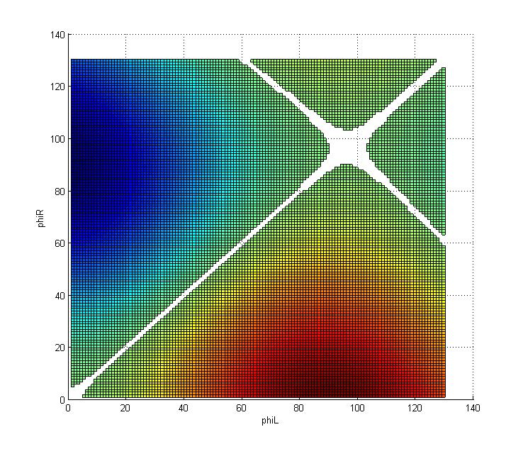
Determinant Plots

Slide 7
Determinants are valued ±2.0
Determinants < ± 0.01 were set as NULL
This plot neglects coupling
Hinge line angle is 15º
Positive determinant – scaling and rotation
Negative – scaling, rotation and reflection

Slide 8
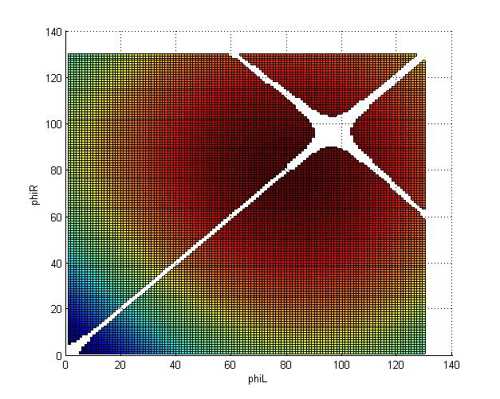
Maximum Yaw Torque
0.128 to 1.982 ft-lbs

Slide 9
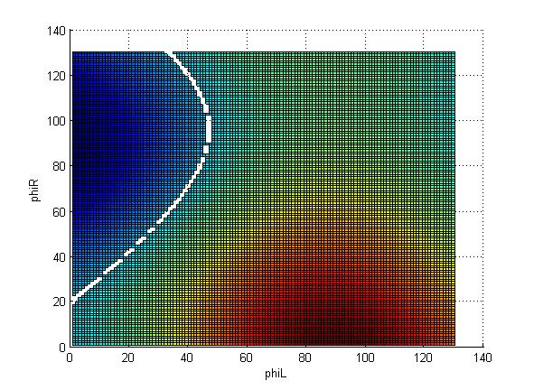
Determinant with Coupling
-1.307-2.647

Slide 10
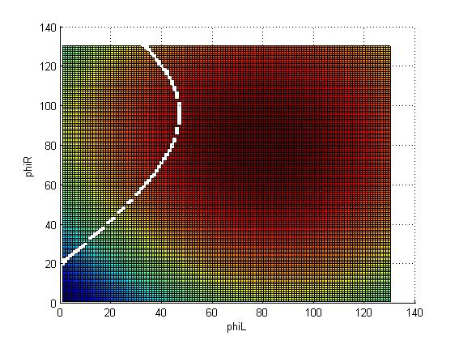
Yaw Torque with Coupling
0.451-2.360 ft-lbs

Slide 11
Goals for Next Semester
Complete attitude + altitude control in hover
Optimize geometry
More accurate mass model
Progress on forward flight control
At minimum 2 conference submissions
Quals

Slide 12
Goals for 2014
Finalize forward and hover control
Hardware design to construction stage
Component selection
Vehicle and launcher
Validate simulation results externally
X-Plane?

Slide 13
Project Goals
Successful construction of vehicle
Successful construction of launcher
Thesis documenting entirety of project

